Slide 1
CTS QUANTS
Vignesh m

Slide 2
log₅ 5x + log₇ 7 =3²
a) x= 5
b) x= 8
c) x= 5⁷
d) x=3

Slide 3
Micro - sims pvt.Ltd produces 1200 phones everyday.If out of these 2 1/3 % are faulty and 4 1/3 % are defective in packaging then how many non-faulty and non defective packaged phones are produced everyday?
a) 1080
b) 80
c) 1120
d) 120

Slide 4
If 7^{a+4} * 5^{b} = 1715, then ab=
a) -1
b) 2
c) 0
d) 4

Slide 5
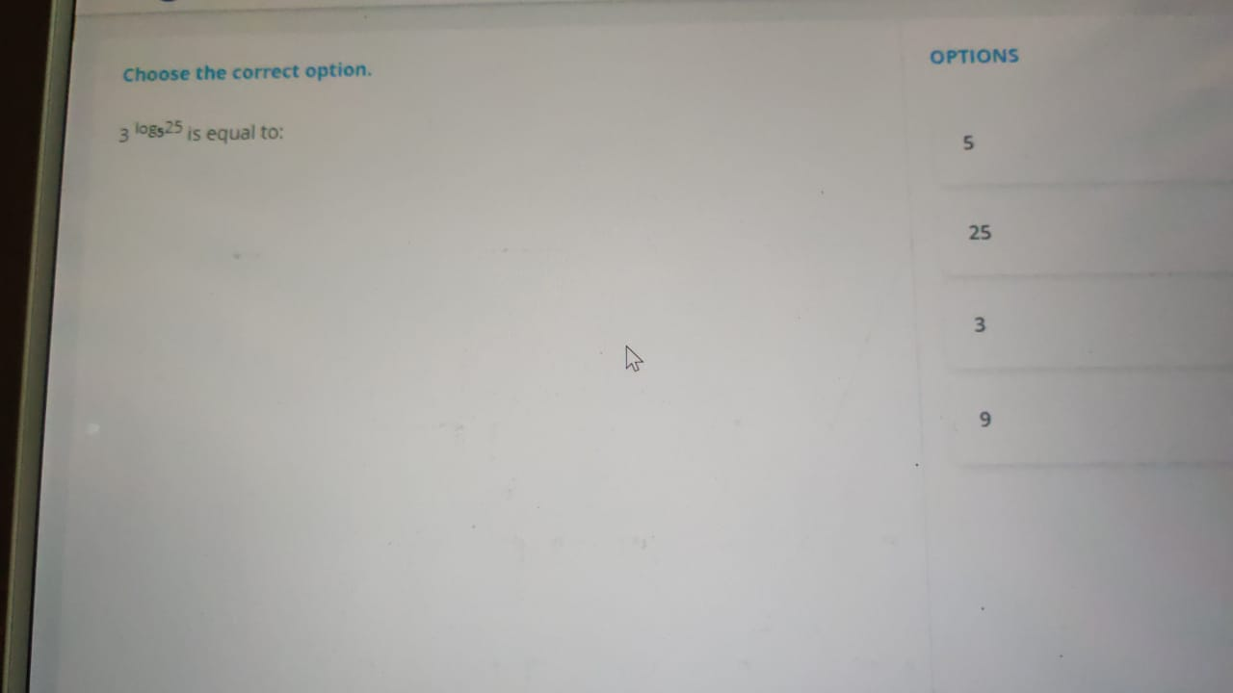

Slide 6
HCF of two numbers is 17. If the numbers are in the ratio 3:7, then their LCM is
a) 255
b) 257
c) 355
d) 357

Slide 7
The corrrect value of log₂₅5- log₄₉7 is
a) 1
b) 0
c) -1
d) 2

Slide 8
The value of p in log_{p} 25p = 2 is
a) 23
b) 24
c) 25
d) 26

Slide 9
If LCM and HCF of two numbers are 162 and 9 respectively. Prime factors of the product of two numbers are ?
a) 3 and 7
b) 3 and 5
c) 2 and 5
d) 2 and 3

Slide 10
Ratio between speeds of 2 trains is 5:3. If the first train runs 350 km in 2 hours.Then what is the speed of second train?
a) 105 kmph
b) 100 kmph
c) 210 kmph
d) 115 kmph

Slide 11
A trend was observed in the growth of population in saya islands.The population tripled after every month.Initially, the population of saya islands was 100. What would be its population after 4 months ?
a) 100 * 3⁴
b) 100 * 4³
c) 100*3*4
d) (100³)⁴

Slide 12
If log_{(a+b}) (a-b)=1, then what is the value of log_{(a+b)} (a²-b²) ?
a)2
b) 1
c) -1
d) 0

Slide 13
log₄ 2 + log₄ 32 is equal to
a) 5
b) 4
c) 2
d) 1

Slide 14
Sameer plants 7225 plants, so that there are as many rows as there are trees in a row. how many trees are there in a row ?
a) 95
b) 85
c) 75
d) 65

Slide 15
If sum of two numbers is 27 anf their HCF and LCM are 3 and 60 respectively.Then the sum of the reciprocal of the two numbers is ?
a) 1/5
b) 3/10
c) 1/10
d) 3/20

Slide 16
What is the least numebr by which 1570 must be divided to get a number which is a perfect square ?
a) 35
b) 7
c) 42
d) 30

Slide 17
The LCM of two numbers is 35322.If the numebrs are in the ratio 1:3. Then Their HCF is
a) 35322
b) 23542
c) 11774
d) 58870

Slide 18
log₄ 16 + log₄ 32 - 3log_{sqt16} 2 = x the solve for x
a) x=4
b) x=5
c) x= 4⁵
d) x= 2³

Slide 19

What is the value of log_{sqt6} 1296 ?
a) 6
b) 8
c) 4
d) $\sqrt{6}$

Slide 20
the GCD of x² - (p-1) and x²-px+(p-1) is x-1 then the value of p is
a) -1
b) 1
c) -2
d) 2

Slide 21
A bag contains 6 blue balls and 3 green balls and a box conains 4 blue balls and 5 green balls. Find the probability that a ball randomely selected from either of them is a blue ball.
a) 1/3
b) 2/9
c) 5/9
d) 5/18

Slide 22
Both Shruthi and pooja randomly choose a colour from red, orange and yellow. What is the probability that both choose orange ?
a) 1 /9
b) 1/6
c) 1/3
d) 2/3

Slide 23
The HCF of two numbers is 16.Which of the following is can never be their LCM?
a) 64
b) 78
c) 112
d) 128

Slide 24
The LCM aof 2⁶ x 3² x 5 x 7 , 2³ x 3⁵ x 7 and 2 x 3⁴ x 5 is
a) 2⁶ x 3⁵
b) 2⁶ x 3⁵ x 5
c) 2⁶ x 3⁵ x 7
d) 2⁶ x 3⁵ x 5 x 7

Slide 25
Which number is divisible by 11?
a) 2118
b) 216
c) 2114
d) 2112

Slide 26
Simplify (3/7 + 22 4/7 -2/8 divided by 1/4)
a) 21
b) 3 2/7
c) 22
d) 3 3/7

Slide 27
(17³ * 17^{5/2} * (17³)^{3/2}) * (17^{10/7} * (17⁵)^{3/35} * (17⁶)^{1/7})⁻¹
a) 175
b) 1712
c) 1
d) 17^{43/7}
d) 17^{51/7}

Slide 28
A started a buisness with Rs. 270000 and was joined by B three month afterwards.How much money did B invest if the profit share of A at the end of the year was three- fifth of the total profit ?
a) 270000
b) 100000
c) 280000
d) 240000

Slide 29
The HCF of 2³x 3² x 5⁴ x 7 x 11,2² x 3² x 7² x 11 and 2⁴ x 5² x 11 is

Slide 30
The number of 6 digit even numbers that can be made from the number 214635 are
a) 72
b) 360
c) 120
d) 18

Slide 31
If LCM and HCF of two numbers are 294 and 49 respectively , product of two numbers can be expressed as ?

Slide 32
population of a village is eight thousand. If 6 % men and 10% women are added. Population becomes 8600 then the number of men in the village was ?
a) 5000
b) 5060
c) 4800
d) 6000

Slide 33
A box contains 5 red , 4 white and 3 green balls.In how many ways can 3 balls be drawn from the box without replacement, so that least 2 of them are green?
a) 18
b) 30
c) 27
d) 9
e) 28

Slide 34
In how many ways can seven similar gifts be distributed to 7clients of a company such that each gets one gift
a) 7C6
b) 7P0
c) 7
d) 7P7

Slide 35
Find n if (2²²⁸/2^{n} ) =512

Slide 36
Compound interest for a certain amount at 13 % p.a for 2 years exceeds the interest on the same amount at 12% p.a for 2 years by 225. Principal amount is
a) Rs.15000
b) Rs. 10000
c) Rs. 22500
d) Rs. 25000
d) Rs. 20000

Slide 37
What is the value of the expression 4²³ x 5²⁰ x 6⁻² x 3²x5⁻⁵ *2⁻⁴⁶x5⁻¹⁰ x 11⁰ x 5⁻⁵ ?
a) 5¹⁰/4
b) 5¹⁰
c) 4
d) 1/4

Slide 38
If log 5 =0.69897 and log 7 = 0.8451 find the value of log 1225
a) 1.5
b) 3
c) 3.1
d) 3.2

Slide 39
100 newspapers cost Rs.125.What is the cost of two pages of the newspaper.When it is known that 1 newspaper comprises of 15 pages ?
a) 16.64 paise
b) 21 paise
c) 8.33 paise
d) 17.00 paise

Slide 40
If u =4 and v=3 then what is the value of log_{(u+v)} (u²-v²)

Slide 41
A light blinks after every 3 seconds, another light blinks after 5 seconds and the third one blinks after every 16 seconds.how many times do they blink together in half an hour?
a) 240 times
b) 8 times
c) 7 times
d) 4 times

Slide 42
Evaluate log 50 + log 75 -log 30 if
log 2 =0.3010: log 3= 0.4771 ; log 5 =0.6989
a) 2
b) 2.2
c) 2.5
d) 1.8

Slide 43
Problem : Four people A,B,C,D are sitting in a row who is sitting at the extreme right?
Staements:
i) C is to the left of D
ii) B is to the left of A
(a) if the data in statement I alone are sufficient to answer the question;
(b) if the data in statement II alone are sufficient answer the question;
(c) if the data either in I or II alone are sufficient to answer the question;
(d) if the data even in both the statements together are not sufficient to answer the
question;
(e) if the data in both the statements together are needed.

Slide 44
0.353535........ x 198.00
a) 6.933
b) 69.33
c) 69
d) 70

Slide 45
THANK YOU

